Slide 1
Medication Abortion
Notes:
This content is developed by Birth Control Pharmacist and made available OPEN ACCESS to pharmacy educators to use in their classrooms.
Contact: mail@birthcontrolpharmacist.com

Slide 2
Objectives
Discuss the current climate of medication abortions in the United States.
Explain the mifepristone REMS program and dispensing requirements.
Review the mechanisms, indications, contraindications, safety, and effectiveness for mifepristone-based regimen for medication abortion.
List counseling points on medications use for medication abortion.

Slide 3
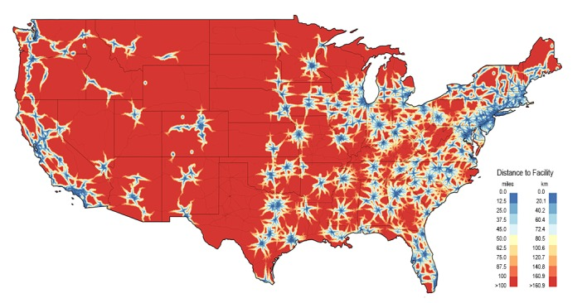
Current Climate
Almost half (45%) of pregnancies in the U.S are unintended
1 in 4 women will have an abortion by age 45
2/3 of abortions happen at 8 weeks of gestation or earlier
Barriers to medication abortion include:
Distance to nearest abortion clinic
Abortion bans currently enacted in many states
Notes:
Map shows the estimated distance to the nearest abortion facility
89% of US counties do no have an abortion provider
38% of reproductive age women live within one of those counties
https://www.guttmacher.org/news-release/2022/guttmacher-institute-releases-2020-abortion-provider-census-important-data-us
https://www.ncbi.nlm.nih.gov/pmc/articles/PMC5972217/

Slide 4
FDA REMS Program for Mifepristone
As of January 2023, mifepristone can now be dispensed in certified community pharmacies
Certified pharmacies are authorized to dispense the medication after receiving a prescription from a certified prescriber under the mifepristone REMS program
Certified pharmacies must:
Fill out the pharmacy agreement form
Keep prescriber agreements on file
Document NDC and lot number for each dose dispensed
Dispense the drug within four days. If patients won’t receive the drug within 4 days, confirm the appropriateness of dispensing with the prescriber.
Notes:
https://www.fda.gov/drugs/postmarket-drug-safety-information-patients-and-providers/questions-and-answers-mifepristone-medical-termination-pregnancy-through-ten-weeks-gestation
The agreement calls for certified pharmacies to:
confirm with the prescriber the appropriateness of dispensing the medication for patients who will receive the drug more than four calendar days after the date the pharmacy receives the prescription
note in the patient’s record the NDC and lot number from each package of the medication dispensed
track and verify receipt of each shipment of the drug
report any patient deaths to the prescriber
keep the identity of patients and prescribers confidential and protected from disclosure except to the extent necessary for dispensing under the REMS or for payment and insurance.
train all relevant staff on the REMS program requirements and must comply with audits carried out by mifepristone sponsors or a third party to ensure all processes and procedures are in place and being followed.
Links to the appropriate forms will be provided at the end of the course

Slide 5
Indications and Contraindications for Medication Abortion
Indications | Contraindications
Medication abortion can be used to terminate a pregnancy up to 70 days (10 weeks) gestation; calculated from first day of last menstrual period. | Patients with an IUD
 | Allergy to medication that will be administered
 | Current long-term users of corticosteroids
 | Anticoagulant therapy/ blood coagulation disorder
 | Ectopic pregnancy

Slide 6
Medications and MOA
Step | 1 | 2
Generic Name | Mifepristone | Misoprostol
Brand Name | Mifeprex | Cytotec
Drug Class | Progesterone Antagonist | Prostaglandin Analogue
Mechanism of Action | Competitively inhibits the actions of progesterone at the progesterone-receptor sites | Causes cervical softening and dilation and uterine contractions

Slide 7
Efficacy And Regimen
Before 10 weeks gestation, mifepristone plus misoprostol was shown to have a high efficacy, up to 97.4%.
FDA Approved Regimen (2016)
Mifepristone dose/route/location | 200 mg (1 tablet) orally, dispensed in office or by pharmacy
Misoprostol dose/route/location | 800 mcg (4 tablets) buccally, dispensed in office or by pharmacy
Misoprostol Timing | Taken 24-48 hours after mifepristone
Other Medications | NSAIDs/analgesics, antiemetics
Follow-up Timing | 7-14 days after mifepristone

Slide 8
Counseling
Medication Instructions Provided
Mifepristone pill should be taken when you’re ready at home, if not already taken at your provider's office or clinic.
Misoprostol pills should be taken together 24-48 hours after the mifepristone was taken. Place two pills inside each cheek for 30 minutes, then swish with water and swallow anything remaining.
Expectations
Bleeding and cramping will start within a couple of hours of taking misoprostol. It’s possible for bleeding to occur after taking mifepristone and before taking misoprostol.
Other common side effects include nausea, diarrhea, fever, chills.
Over-the-Counter Medications
Avoid additional pain medications like ibuprofen, naproxen, and other NSAIDs.
Do not take any more pain pills than your provider recommended. Avoid pain medications like ibuprofen and naproxen. You can take an over-the-counter medicine for diarrhea, if needed.
When to Call Provider
Bleeding that soaks 2 full-sized pads per hour for 2 consecutive hours.
Fever over 101°F or fever over 100.4 °F that lasts more than 4 hours.
Pain not responsive to pain medications or diffuse/severe abdominal pain.
General malaise >24 hours after the last misoprostol dose
If you have minimal bleeding or do not believe the pregnancy has passed, or if you have continued pregnancy symptoms past 7 days.
Confirm patient has provider phone number.

Slide 9
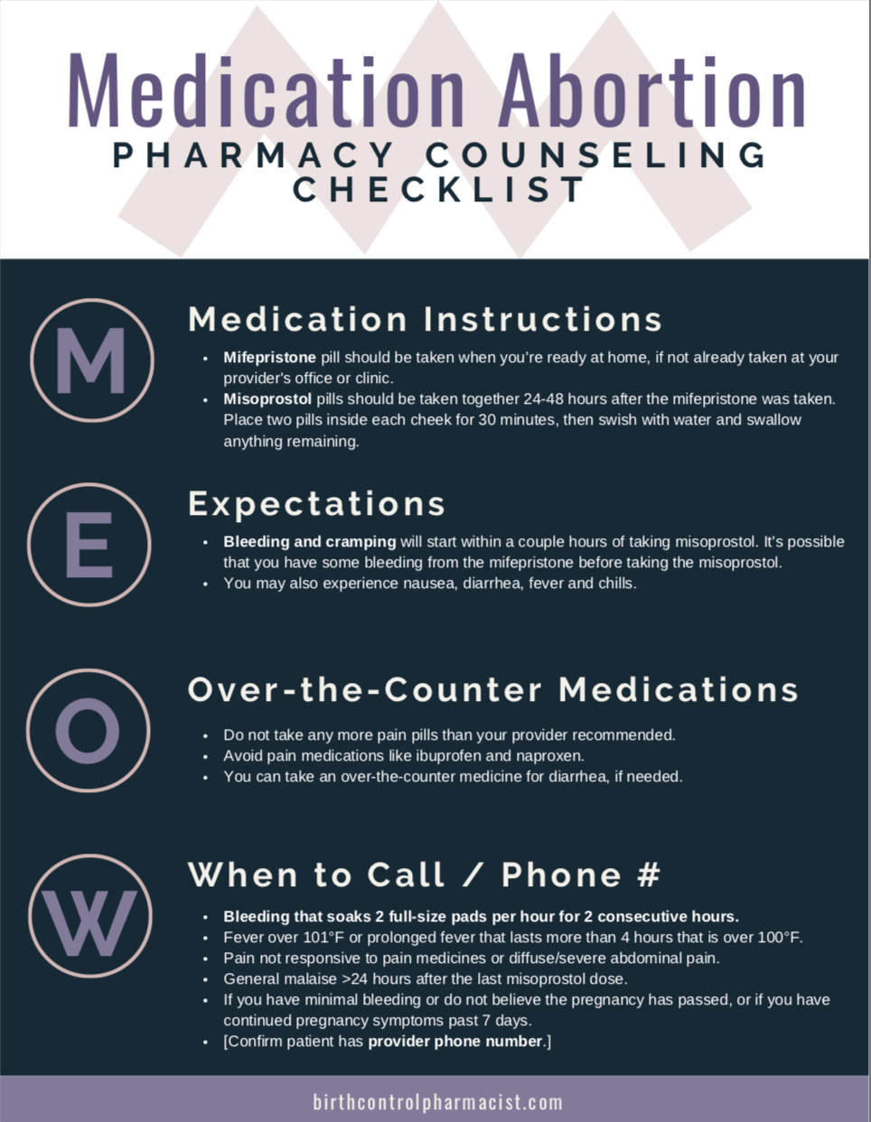
Resources
Clinical Resources
Medication Abortion Pharmacy Counseling Checklist
Pharmacy Referral Guide
Contraception, Emergency Contraception, and Abortion Pharmacy Best Practices Checklist
What to Say to Address Barriers Guide
https://birthcontrolpharmacist.com/resources/
Continuing Education Program
Meeting Reproductive Health Needs at the Pharmacy
https://birthcontrolpharmacist.com/referrals/

Slide 10
External Resources (cont.)
Regulatory Resource
Reliable information on certification, dispensing, and best practices for the pharmacy community providing medication abortion care
https://medicationabortioncareresources.com/
Notes:
Combining the expertise of organizations and individuals across the field, the Medication Abortion Pharmacy Advisory Group provides reliable information on legality, certification, dispensing, and best practices for Medication Abortion (Mifepristone and Misoprostol). This website was created with the assistance and guidance of:
American Pharmacists Association (APhA)
National Association of Boards of Pharmacy (NABP)
The National Alliance of State Pharmacy Associations (NASPA)
National Community Pharmacists Association (NCPA)
Butler University College of Pharmacy and Health Science
Ohio State University College of Pharmacy
Birth Control Pharmacist

Slide 11
https://cmecalifornia.com/lms/ucsf
Notes:
This 1-hour home-study activity was initially released on August 1, 2020 and expires on July 31, 2023. There is no charge to participate, complements of ANSIRH, and it has received no commercial support.
Link: https://cmecalifornia.com/lms/activity?@curriculum.id=-1&@activity.id=7154580

